Slide 1
Datalogic Group
October, 2015

Slide 2

Datalogic at a Glance
Global leader in Automatic Data Capture and Industrial Automation markets
World-class producer of barcode readers, mobile computers, sensors, vision systems and laser marking systems with innovative solutions in retail, manufacturing, transportation & logistics and healthcare industries
2014 Revenues at 464.5 M Euro of which 66.3% in the ADC Market and 28.0% in the Industrial Automation Market
A large portfolio of over 1,100 patents worldwide
Founded in 1972 by Romano Volta in Bologna, Italy and listed on the STAR Segment of the Italian Stock Exchange since 2001
About 2,470 employees, of which 408 in R&D
Direct presence in 30 countries worldwide selling to 120 countries

Slide 3
A history of organic growth and acquisitions
Acquisition of Informatics Inc.
Acquisition of Accu-Sort Systems Inc.
Acquisition of PSC Inc.
Acquisition of PPT Vision Inc.
Established in Bologna
Listing on the Milan Stock Exchange
Acquisition of Laservall SpA
Acquisition of Evolution Robotics Retail Inc.
Acquisition of Escort Memory Systems Inc.
Acquisition of Multiwave Photonics SA
Acquisition of Minec AB
Acquisition of Datasensor SpA
Acquisition of IDWare Mobile Computing & Comm.
Set up Business Development Division
1972
1988
1997
2001
2002
2004
2005
2008
2010
2011
2012
2013

Slide 4
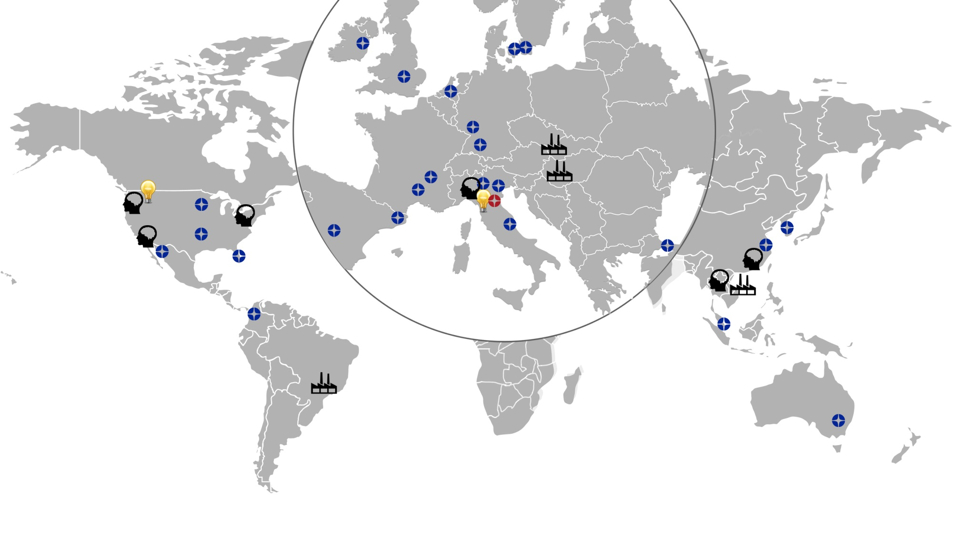




A Wide Geographical Footprint
EUROPE 42,6%
NORTH AMERICA 28,9%
ITALY 9,6%
APAC 12,3%
ROW 6,6%
Note: Breakdown by area based on 2014 revenues
Direct presence in 30 countries worldwide
Manufacturing Sites 12 R&D Centers
2 DLLABS
4

Slide 5
Revenues Trend
REVENUES BY DIVISION
REVENUES BY AREA
€000 | 2013 | 2014 | Var %
Datalogic ADC | 282.1 | 308.2 | 9.2%
Datalogic Automation | 137.8 | 130.2 | 5.5%
Informatics | 30.8 | 26.1 | 14.9%
Total revenues | 450.7 | 464.,5 | 3.1%
€000 | 2013 | 2014 | Var %
Italy | 38.040 | 44.489 | 17.0%
Europe | 183.810 | 197.846 | 7.6%
North America | 143.876 | 134.455 | 6.5%
Asia Pacific | 56.455 | 57.154 | 1.2%
ROW | 28.556 | 30.602 | 7.2%
Total revenues | 450.737 | 464.546 | 3.1%

Slide 6

A New Strategic Paradigm
Innovative products
Competitive advantage
Customer
Focus
People
Engagement
Market
Expansion
Increase revenues

Slide 7

Customer Focus: Invest in Technology and Develop Excellent Products
Core Competences
New Emerging Technologies
Integration Office
New Business Development Division to meet and anticipate current and future customer needs
Focus on Vision and Imaging technologies
Focus on breakthrough innovations
Improve market shares
Research & Development investments from 7% to over 8% on sales
  NEW
  BUSINESS DEVELOPMENT
  DIVISION
7
7

Slide 8
Relentless Innovation
PRODUCT INNOVATION
A large and growing portfolio of over 1,150 patents and patent applications
About 300 pending patent applications in all jurisdictions
21% of sales from new products*
25 new products launched in 2014
12 Research & Development Centers
Around 400 R&D Engineers
PATENT PORTFOLIO
    * Are considered new products the products announced in the last 24 months

Slide 9
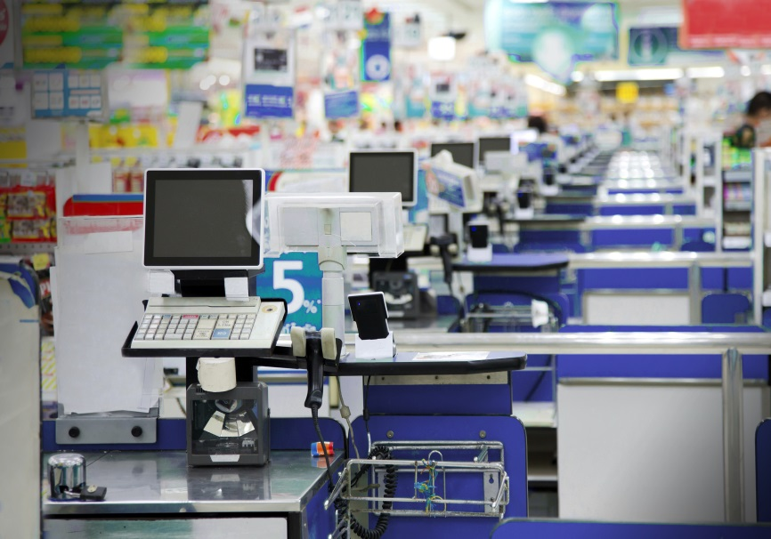


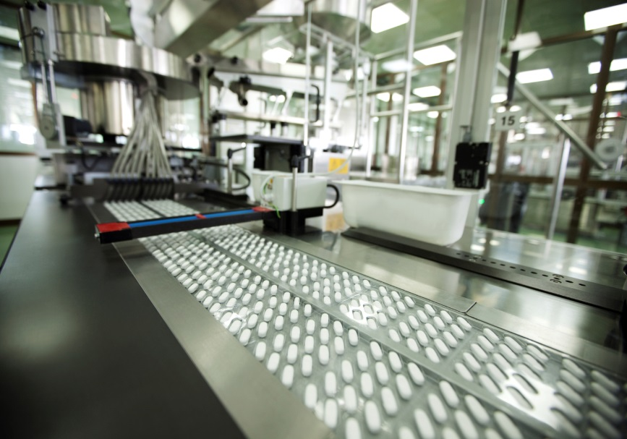
Customer Solutions in Reference Markets
RETAIL
MANUFACTURING
TRANSPORTATION & LOGISTICS
HEALTHCARE

Slide 10




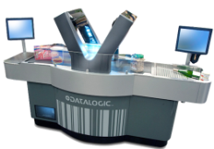
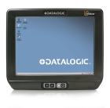


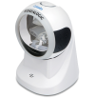


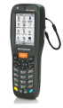
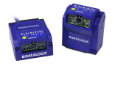

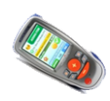

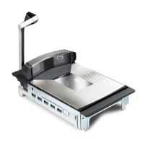
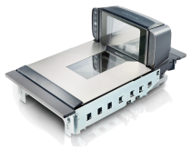
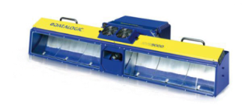
Retail: 47 % of Revenue*
POS
Store mngt
Warehouse
Most innovative solutions
Multi-tier model
New products
Tailored services
New Products
Bundle solutions
* Figures as of 31 December 2014

Slide 11

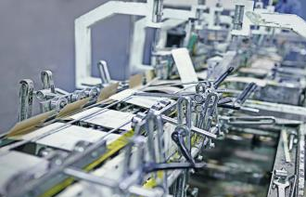

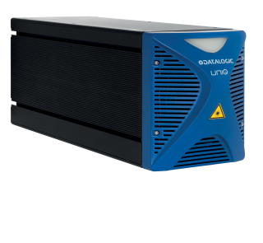
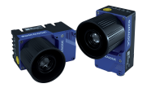
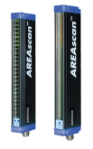



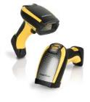
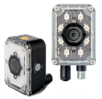
Manufacturing: 30% of Revenue*
Warehouse
Shop floor
Automation
New Products
Bundle solutions
Leverage EMEA MKT share as a reference
Geographical expansion leverage barcode, marking and inspection
* Figures as of 31 December 2014

Slide 12
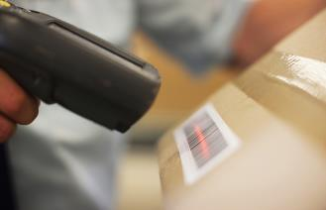
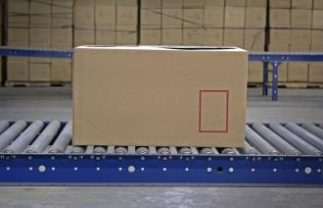



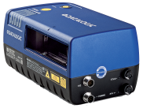


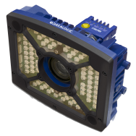
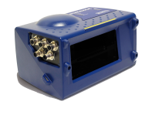
T&L: 15% of Revenue*
Shipping & Receiving
Sorting
Delivery
Geographical coverage
leverage barcode, marking and inspection
Strengthen the relation with key customers
New products
tailored services
* Figures as of 31 December 2014

Slide 13
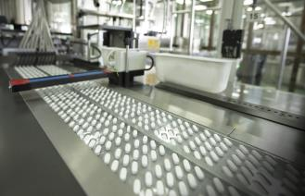


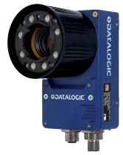
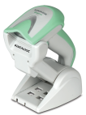


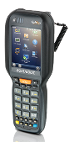

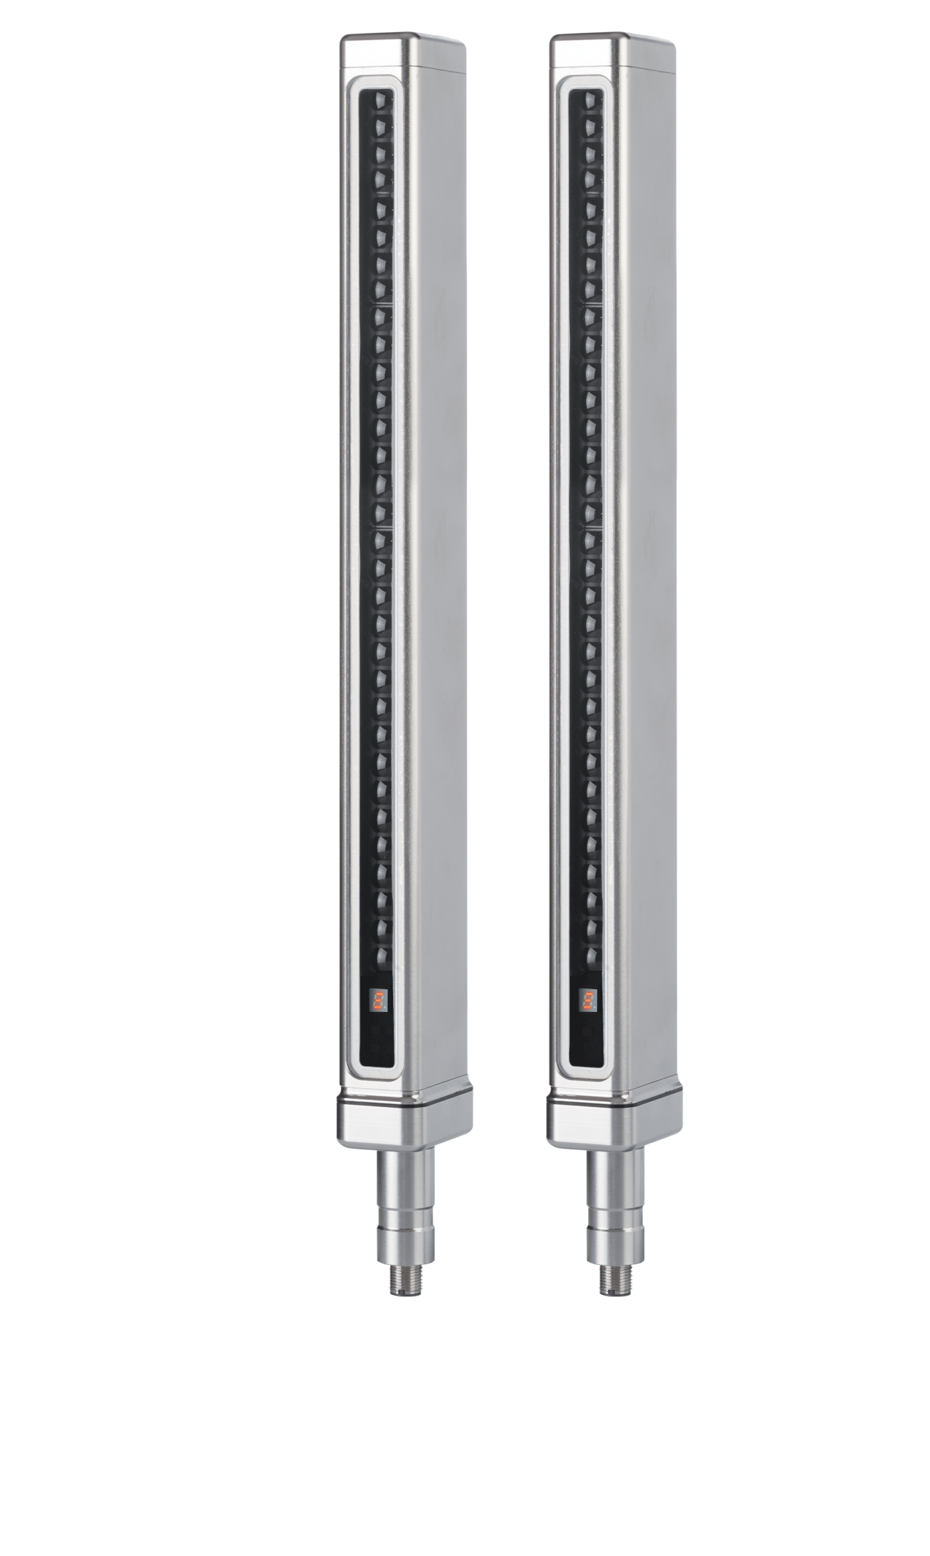

Healthcare: 6% of Revenue*
Manufacturing
Inventory mngt
Bed side care
Expand geography
Mark and Verify solutions
Tailored services
Promote the use of professional device
Most innovative solutions
New Products
* Figures as of 31 December 2014

Slide 14

Market Trend: Two Speeds for ADC and IA
Automatic Data Capture
Industrial Automation
Strong recovery ahead with forecast reviewed upward for the entire period: CAGR 2013-2016 +5.0%
Positive market trend in all the segments Datalogic is operating in
Laser marking technology and machine vision increase their applications in the factory environment
CAGR + 5.0%
5.22B$
CAGR + 5.1%
4.56B$
4.51B$
3.93B$
CAGR + 3.1%
CAGR + 4.4%
CAGR + 3.3%
CAGR + 7.5%
CAGR + 5.0%
CAGR + 7.5%
CAGR + 5.1%
CAGR + 12.7%
CAGR + 5.1%
Source VDC 2014 (base year 2013)
Source VDC 2014 (base year 2013) Preliminary Figures - Market Researches and Management's Best Estimate

Slide 15
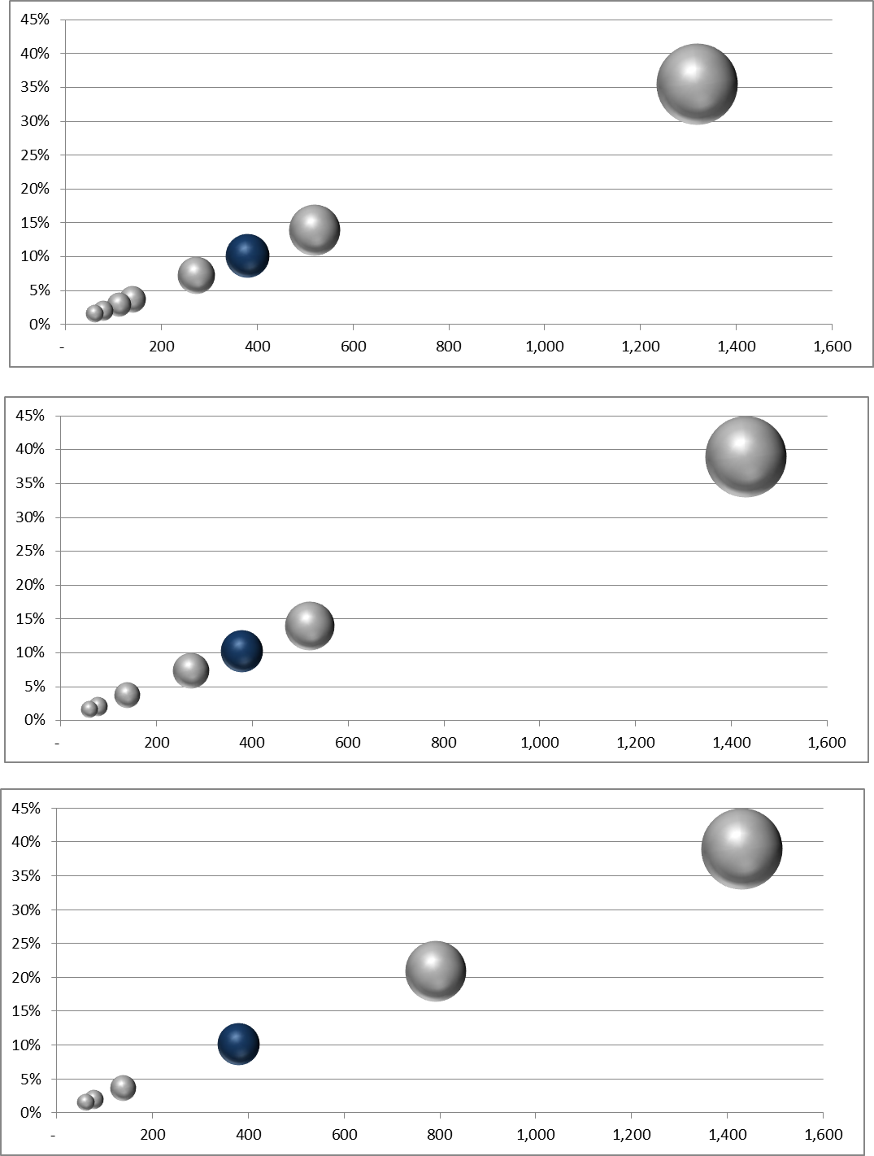







Datalogic positioning in the ADC market
ADC Market Share around 10%
POS Retail Scanners
#1 WW – 32.8% mkt share
Handheld Scanners
#1 in EMEA – 32.8% mkt share
#3 WW – 16.9% mkt share
Mobile Computers
#3 in EMEA – 9.4% mkt share
#3 WW – 4.7% mkt share
2013 Market Share
2013 Revenues in $M
2013 ADC Available Market including POS Retail Scanners, Handheld Scanners and Mobile Computers (Hand Held , PDA and Fork-Lift Vehicles Mounted Computer) segments
Source VDC 2014 (base year 2013)

Slide 16








Datalogic positioning in the IA market
2013 Market Share
12%
Industrial Stationary Scanners
#1 WW - 26.2% mkt share
8%
6%
4%
2%
$100 M
$200 M
$300 M
2013 Revenues in $M
2013 IA Available Market including Industrial Barcode Scanners, Imagers, Photoelectric Sensors, Safety Light Curtains, Smart Cameras/Vision Sensors, Laser Marking segments (Postal Material Handling, Dimensioner and Integrated Solutions not included)
Source : VDC 2014 (base year 2013) Preliminary Figures - Market Researches and Management's Best Estimate

Slide 17

Datalogic and Vietnam

Slide 18

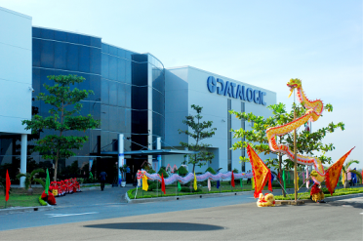
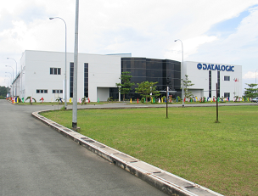
Vietnam Datalogic ADC Overview: we are here
We are in the Saigon Hi-Tech Park
Established: 8-Jan-2009
Factory land area: 2 Lots ~20,000m² each.
Building area: 10,000m²
Production area occupied: 4,500m²
1,750 m² office in 1st floor for R&D
About 600 employees
Focus: Product Design and Test, Manufacturing, Fulfillment, and Service Repair

Slide 19
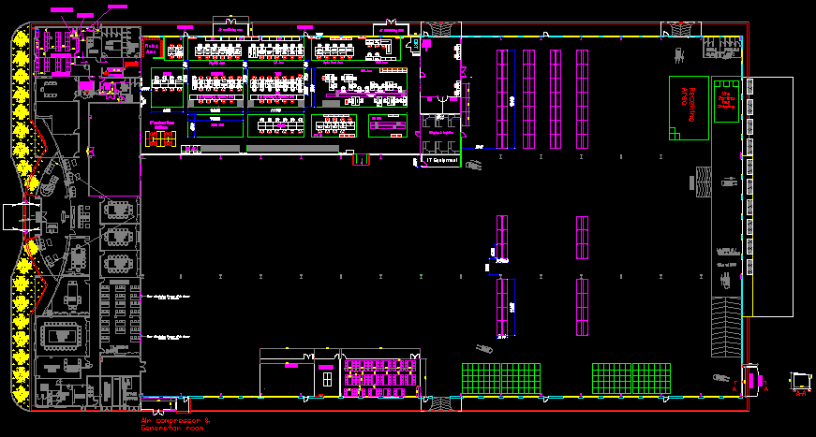
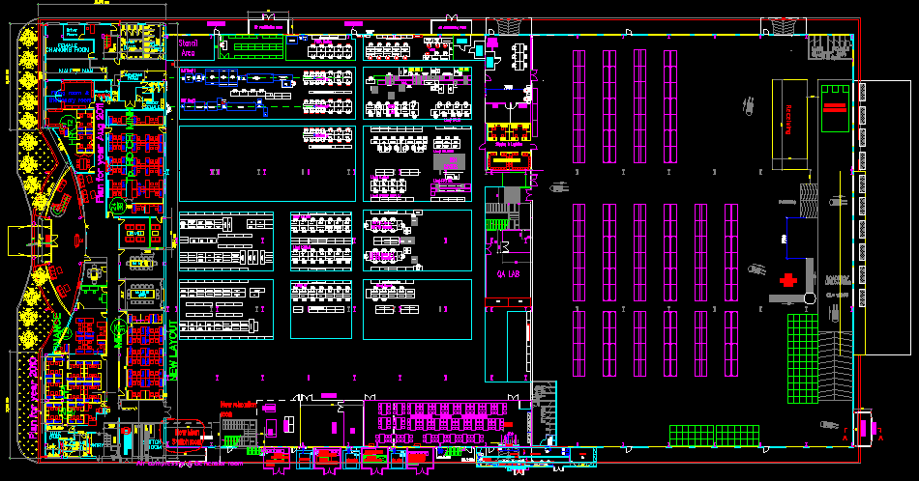
The biggest PLANT in Datalogic!
2010
Total land area: 20,000 m2
Building area: 10,000 m2
Production area: 1,500 m2
2013
Total land area: 20,000 m2,
Building area: 10,000 m2
Production area: 4,500 m2
Mezzanine floor: 3,000 m2

Slide 20
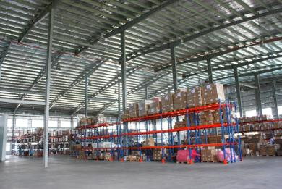
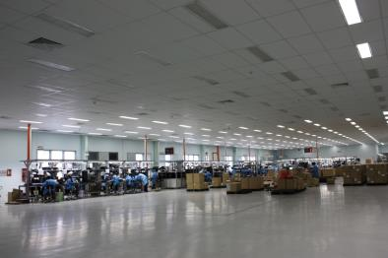
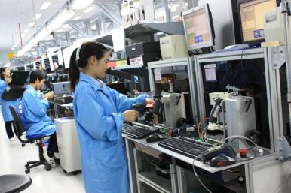
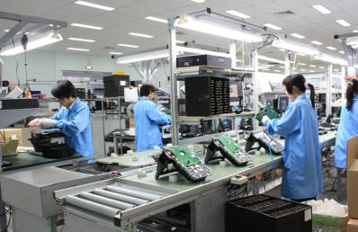
DATALOGIC VIETNAM-Factory floor

Slide 22
Production Output
Family | 2011 | 2012 | 2013 | 2014 | 7m-2015 | Grand Total
FRS | 105,460 | 111,423 | 135,728 | 175,068 | 128,973 | 656,652
HHS | 343,570 | 627,450 | 935,183 | 1,066,486 | 675,414 | 3,648,103
MOB | 14,955 | 70,000 | 79,664 | 105,619 | 87,801 | 358,039
Grand Total | 463,985 | 808,873 | 1,150,575 | 1,347,173 | 892,188 | 4,662,794

Slide 23
Daily Output & Increasing rate
 | 2011 | 2012 | 2013 | 2014 | 7M - 2015
Daily Output | 1550 | 2700 | 3800 | 4500 | 5100
Increasing rate |  | 74.2% | 40.7% | 18.4% | 13.3%

Slide 24
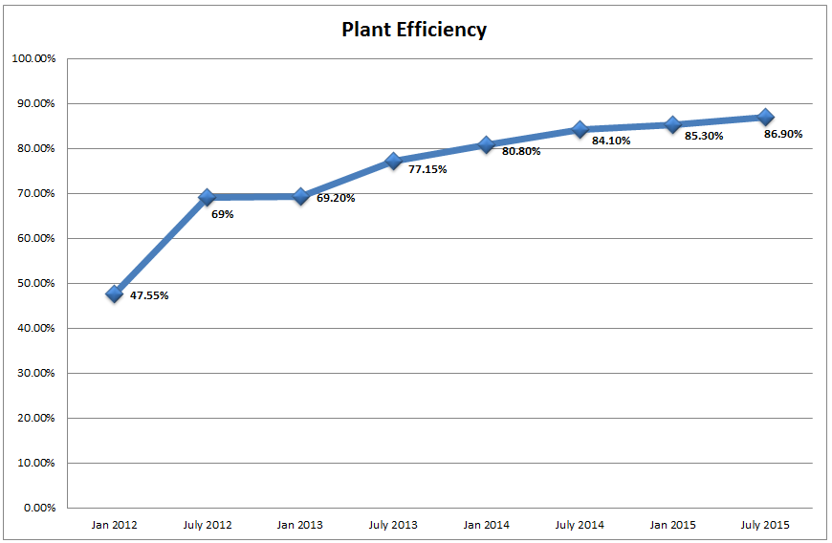
PLANT EFFICIENCY

Slide 25
Datalogic Vietnam R&D
From 2009, our original planned goals:
“…..
  To bring into our New Products: ideas, design and innovation from the hand and brains of Asian Engineers and a frontline on-site support for our Operations
  To be closer to the Asian Market and Asian Supply Chain starting from Design
  Software quality is an opportunity for driving improvement in field quality and we have a focused software development and test team in VN to continually improve that discipline
  Increasing complexity in products requires increasing efficiency of R&D investments➔ having the right resources at the right cost for the right task….”

Slide 26
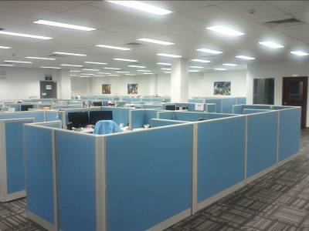
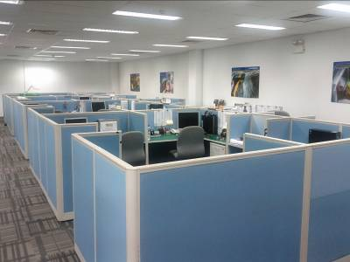
Datalogic Vietnam New Product Engineering: Today
Today, 4,5 years later…➔ the first offshore center for DL is a reality, one of the biggest Design Center in Datalogic!

Slide 27







Datalogic in VN: Cooperation with universities

Slide 28




Cooperation with Universities in VN
Job fairs
We opened up a Joint-LAB on Advanced Embedded Systems with Texas Instruments in HCMUT
Annual Summer Internship in July
Guest lectures
Annual Engineering scholarship in October
Hiring HCMUT professor for Professional in-house courses
Factory Tour for students
Mostly students from Faculties: Computer Science, Electrical – Electronic, Mechanical, Industrial Management

Slide 29

Cooperation: International Universities Commitees
Based in Saigon Hi-Tech Park and cooperate with SHTP on various committees
Cooperation with HEEAP (Higher Engineering Education Alliance Program) and being part of the VEEC 2014 (Vietnam Engineering Education Conference)
Chairman, Industry Engagement Committee (IEC), Centre of Technology, Royal Melbourne Institute of Technology

Slide 30
Thank you!
Datalogic S.p.A.
Via Candini, 2
40012 Lippo di Calderara di Reno
Bologna – Italy
Tel. +39 051 3147011
Fax +39 051 3147205
E-mail corporate@datalogic.com

